Slide 1


nnAttention U-net for Brain Tumor Segmentation
Mattia Capparella
ID Number 1746513
Advisor
Maria de Marsico
External Advisors
Ilaria Gianoli Manuel Orlandi

Slide 2
Introduction
Selezionare per scrivere o eliminare il sottotitolo

Slide 3

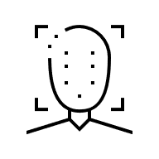

Computer Vision
CLASSIFICATION
DETECTION
SEGMENTATION

Slide 4
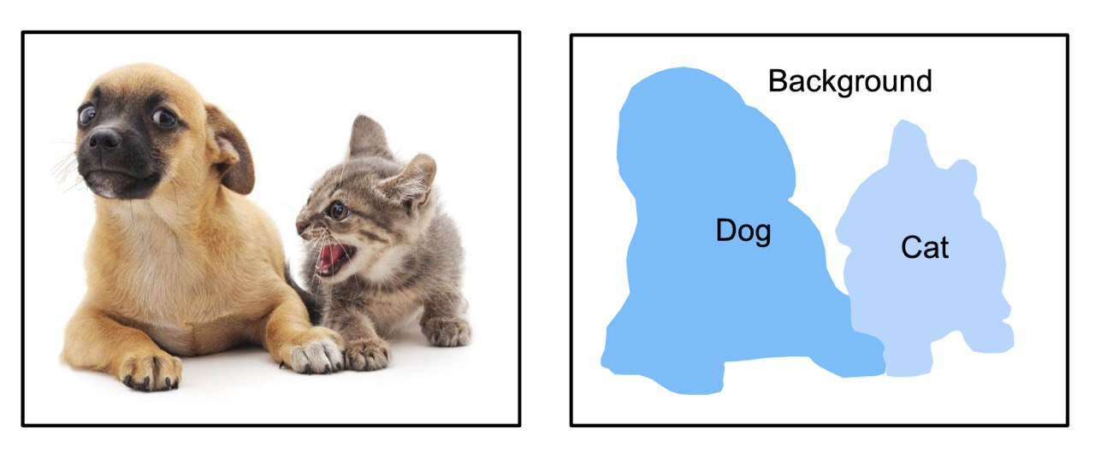
Semantic Segmentation

Slide 5
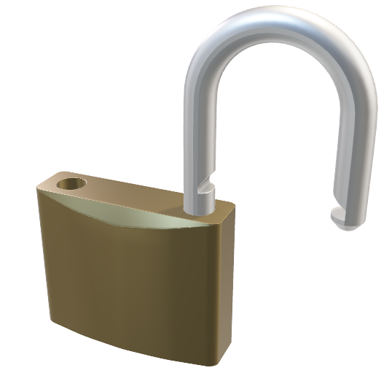

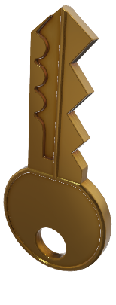
Key Concepts

Slide 6
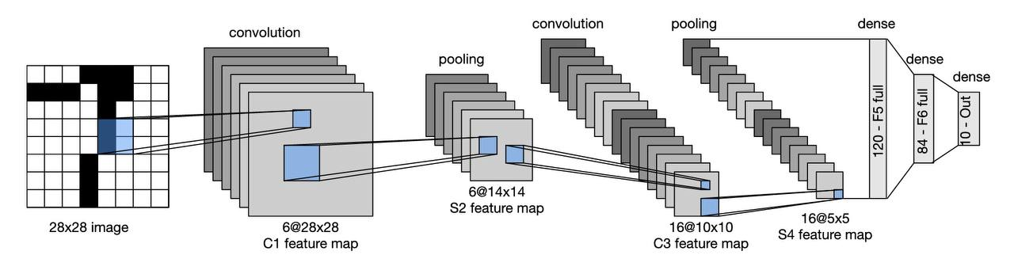
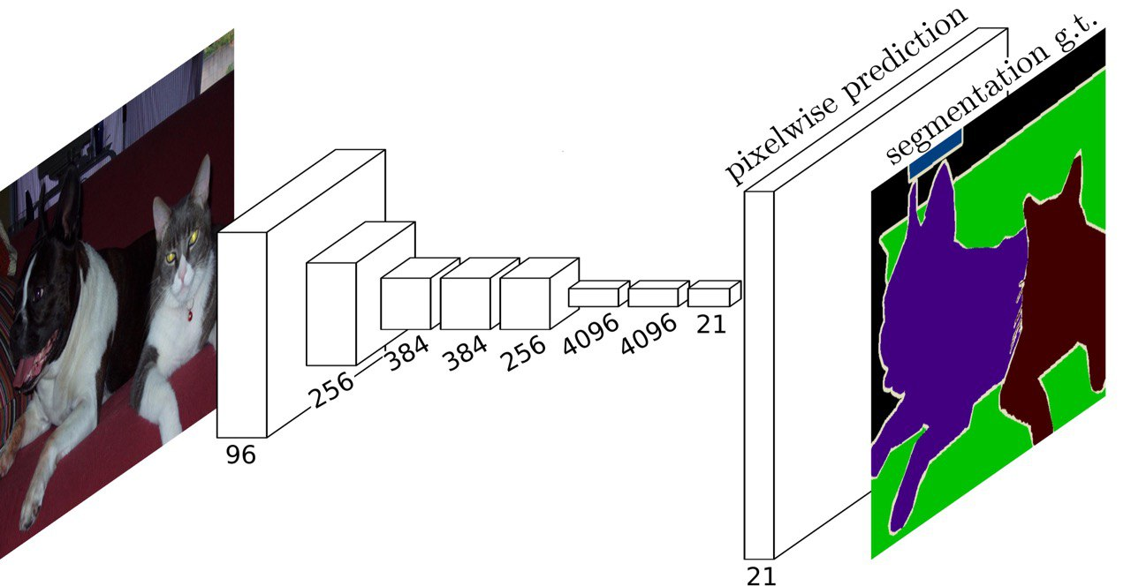
Convolutional Neural Network
Fully Convolutional Neural Network

Slide 7
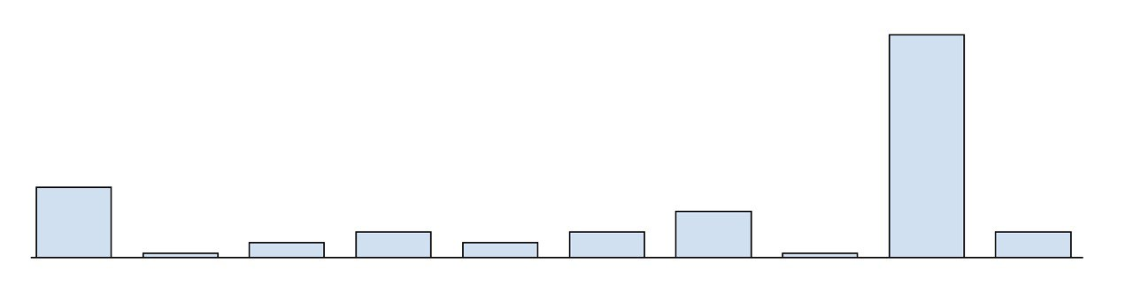
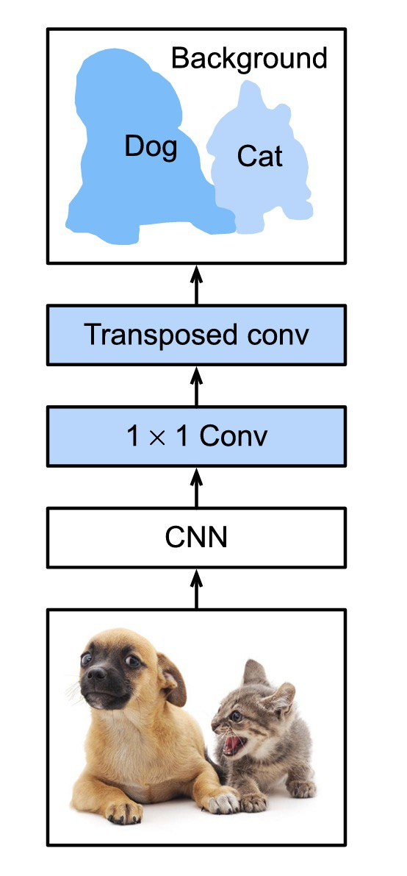
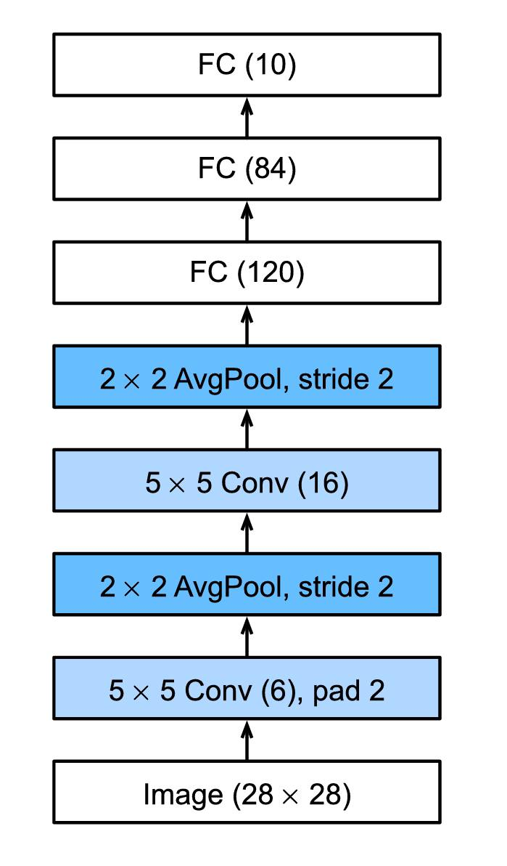
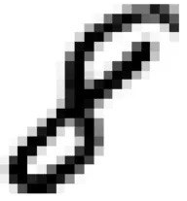

Slide 8
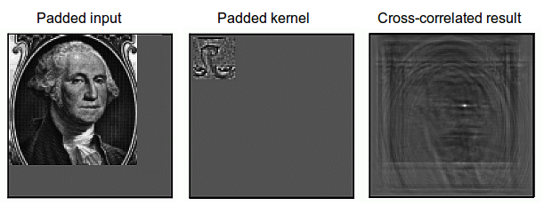
Convolution
Notes:
https://developer.nvidia.com/discover/convolution
https://timdettmers.com/2015/03/26/convolution-deep-learning/
https://www.tutorialspoint.com/signals-and-systems-relation-between-convolution-and-correlation

Slide 9
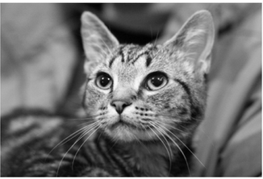
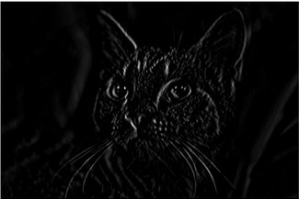
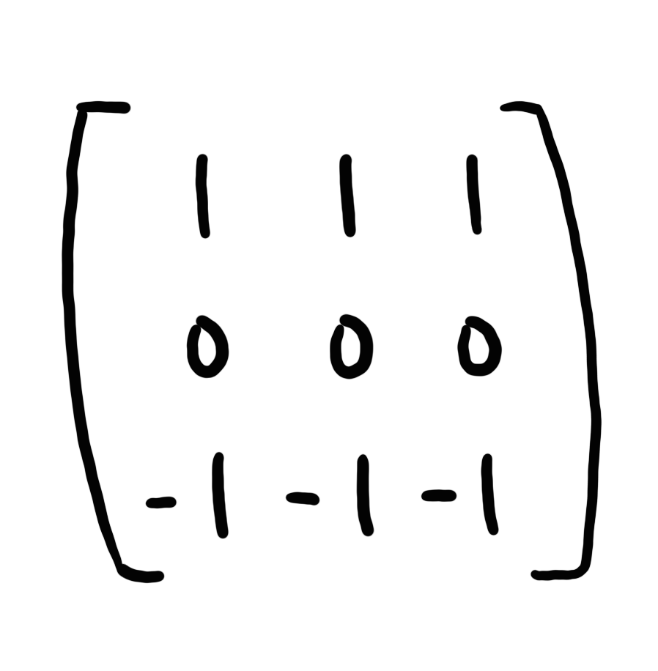
Convolution
Notes:
https://developer.nvidia.com/discover/convolution
https://timdettmers.com/2015/03/26/convolution-deep-learning/
https://www.tutorialspoint.com/signals-and-systems-relation-between-convolution-and-correlation

Slide 10

Attention
Notes:
https://lightning.ai/docs/pytorch/stable/notebooks/course_UvA-DL/05-transformers-and-MH-attention.html
https://uvadlc-notebooks.readthedocs.io/en/latest/tutorial_notebooks/tutorial6/Transformers_and_MHAttention.html
http://jalammar.github.io/illustrated-transformer/
https://lilianweng.github.io/posts/2020-04-07-the-transformer-family/
https://blogs.nvidia.com/blog/2022/03/25/what-is-a-transformer-model/
https://en.wikipedia.org/wiki/Vision_transformer
https://lightning.ai/docs/pytorch/stable/notebooks/course_UvA-DL/11-vision-transformer.html

Slide 11



the problem
proposed solutions
SOTA

Slide 12
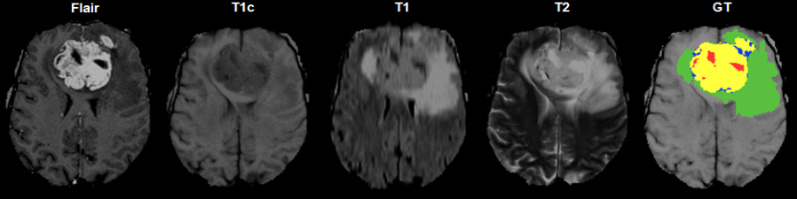
The problem

Slide 13
CSF is dark on T1 imaging
CSF is bright on T2 imaging
CSF is made dark and abnormalities remain bright in FLAIR

Slide 14
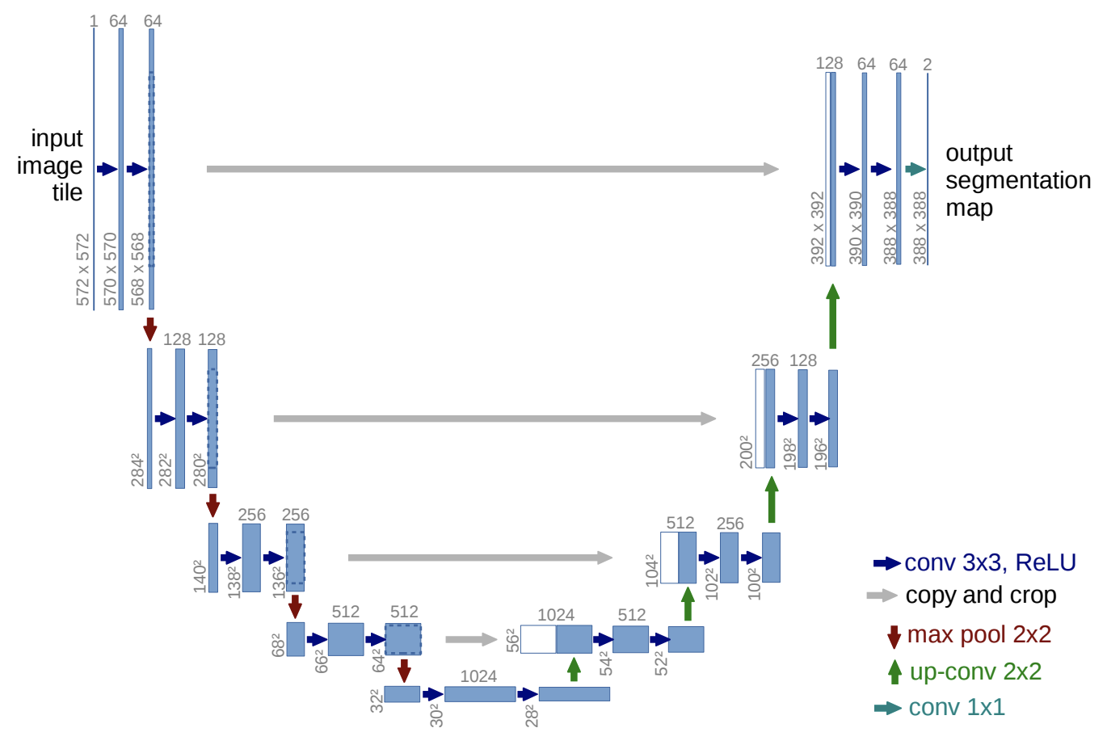
Literature Overview

Slide 15
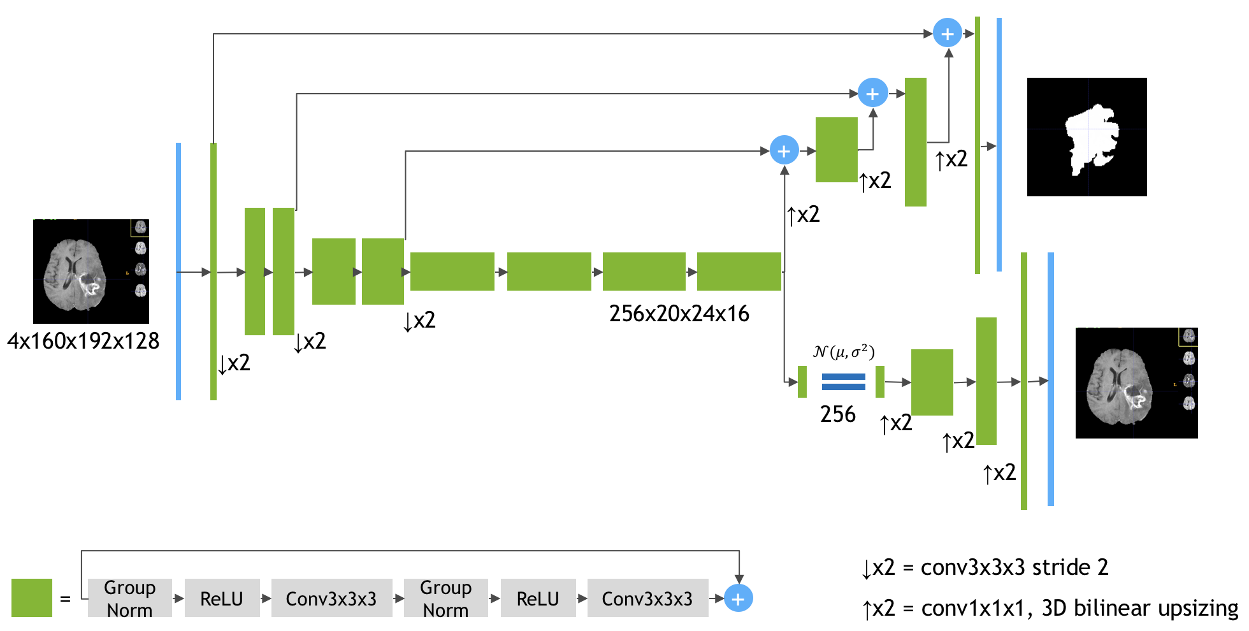
SegResNet
3x160x192x128
4x160x192x128

Slide 16
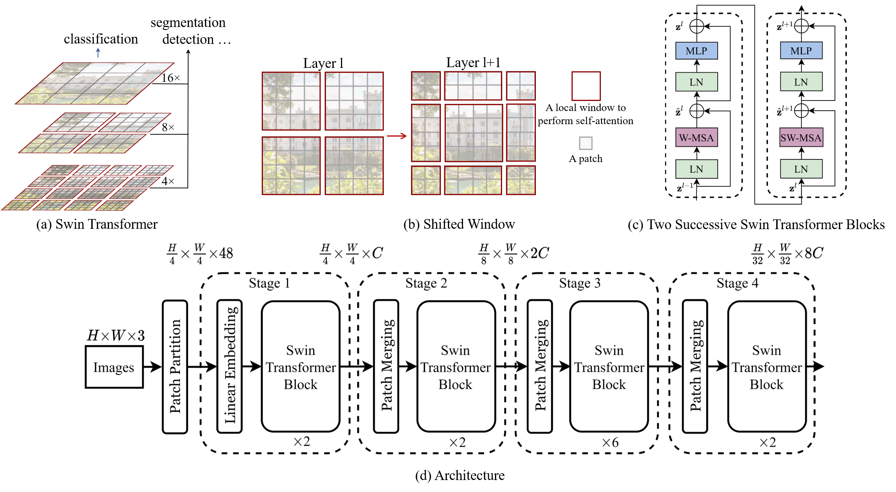
Shifted Windows Transformer

Slide 17
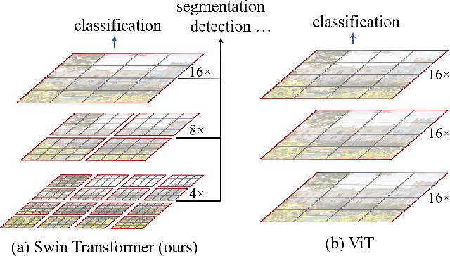
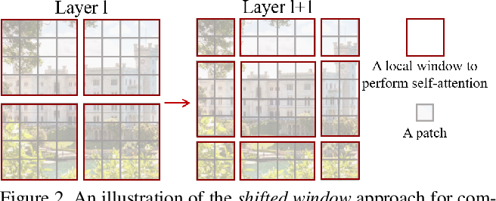
Shifted Window Mechanism
(a.1) Swin-Transformer
(a.2) ViT
(b) Shifted Window

Slide 18
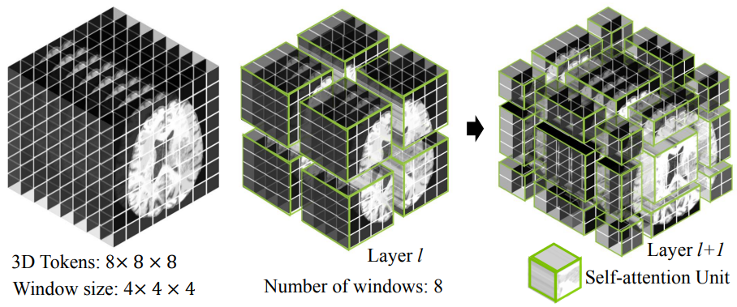
3D Volume shifted segmentation

Slide 19
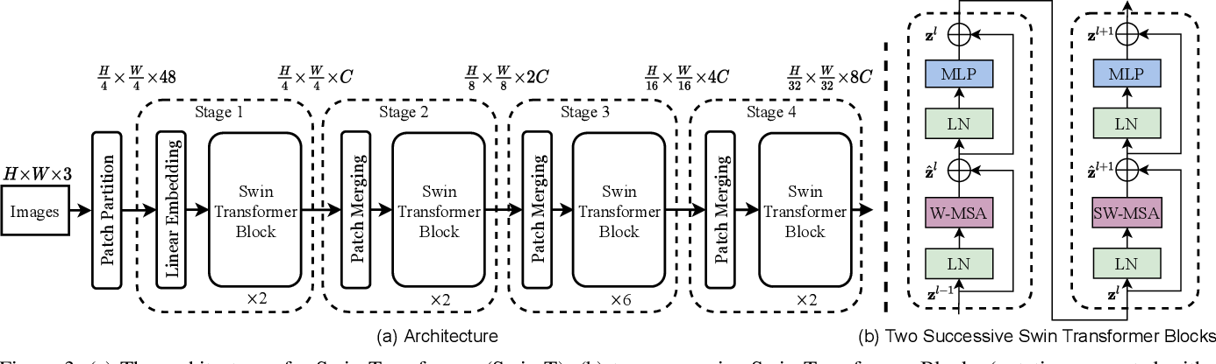
Literature Review

Slide 20
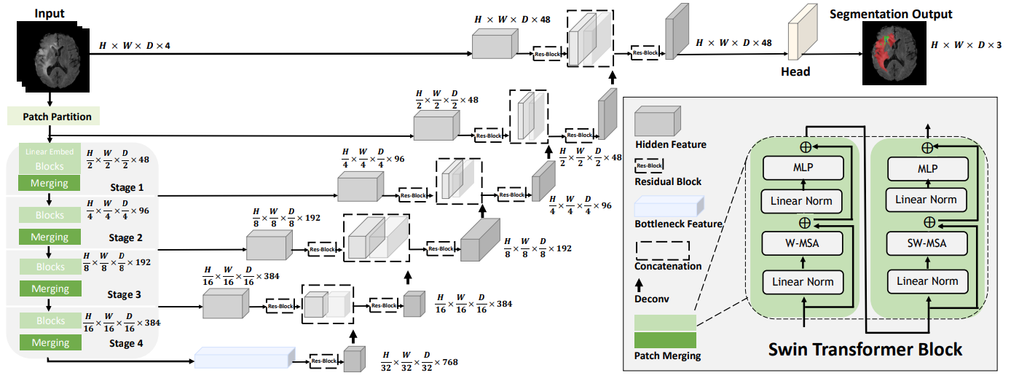
SwinUNETR Transformer

Slide 21
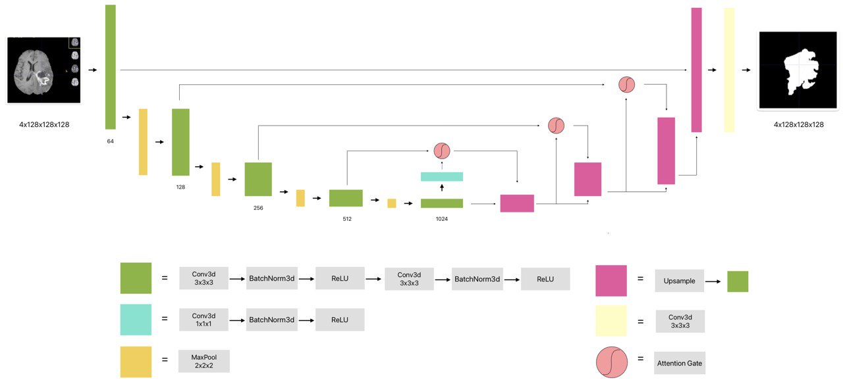
Attention U-Net

Slide 22
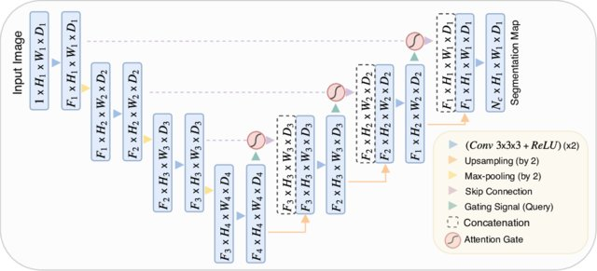

Slide 23
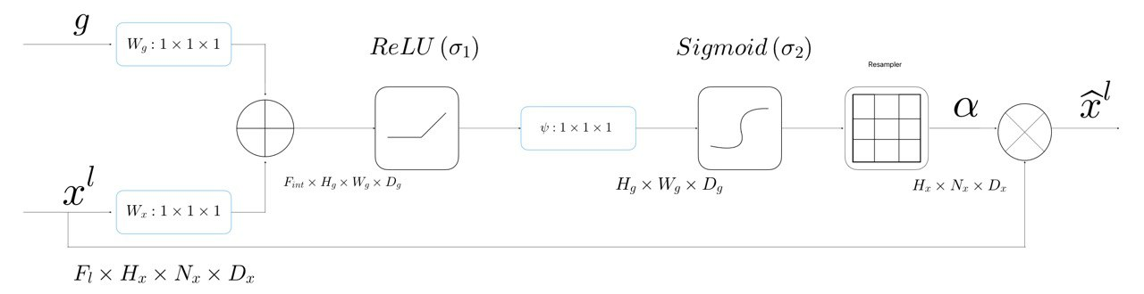
Attention Gate

Slide 24
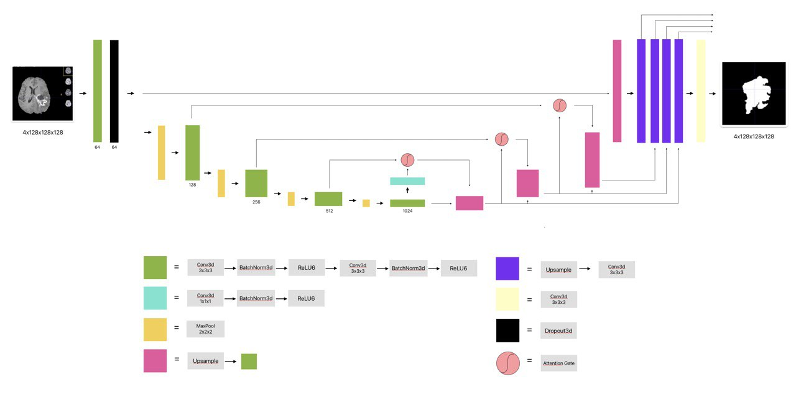
nnAttention U-Net

Slide 25
Methodology

Slide 26





Methodology

Slide 27
Results

Slide 28
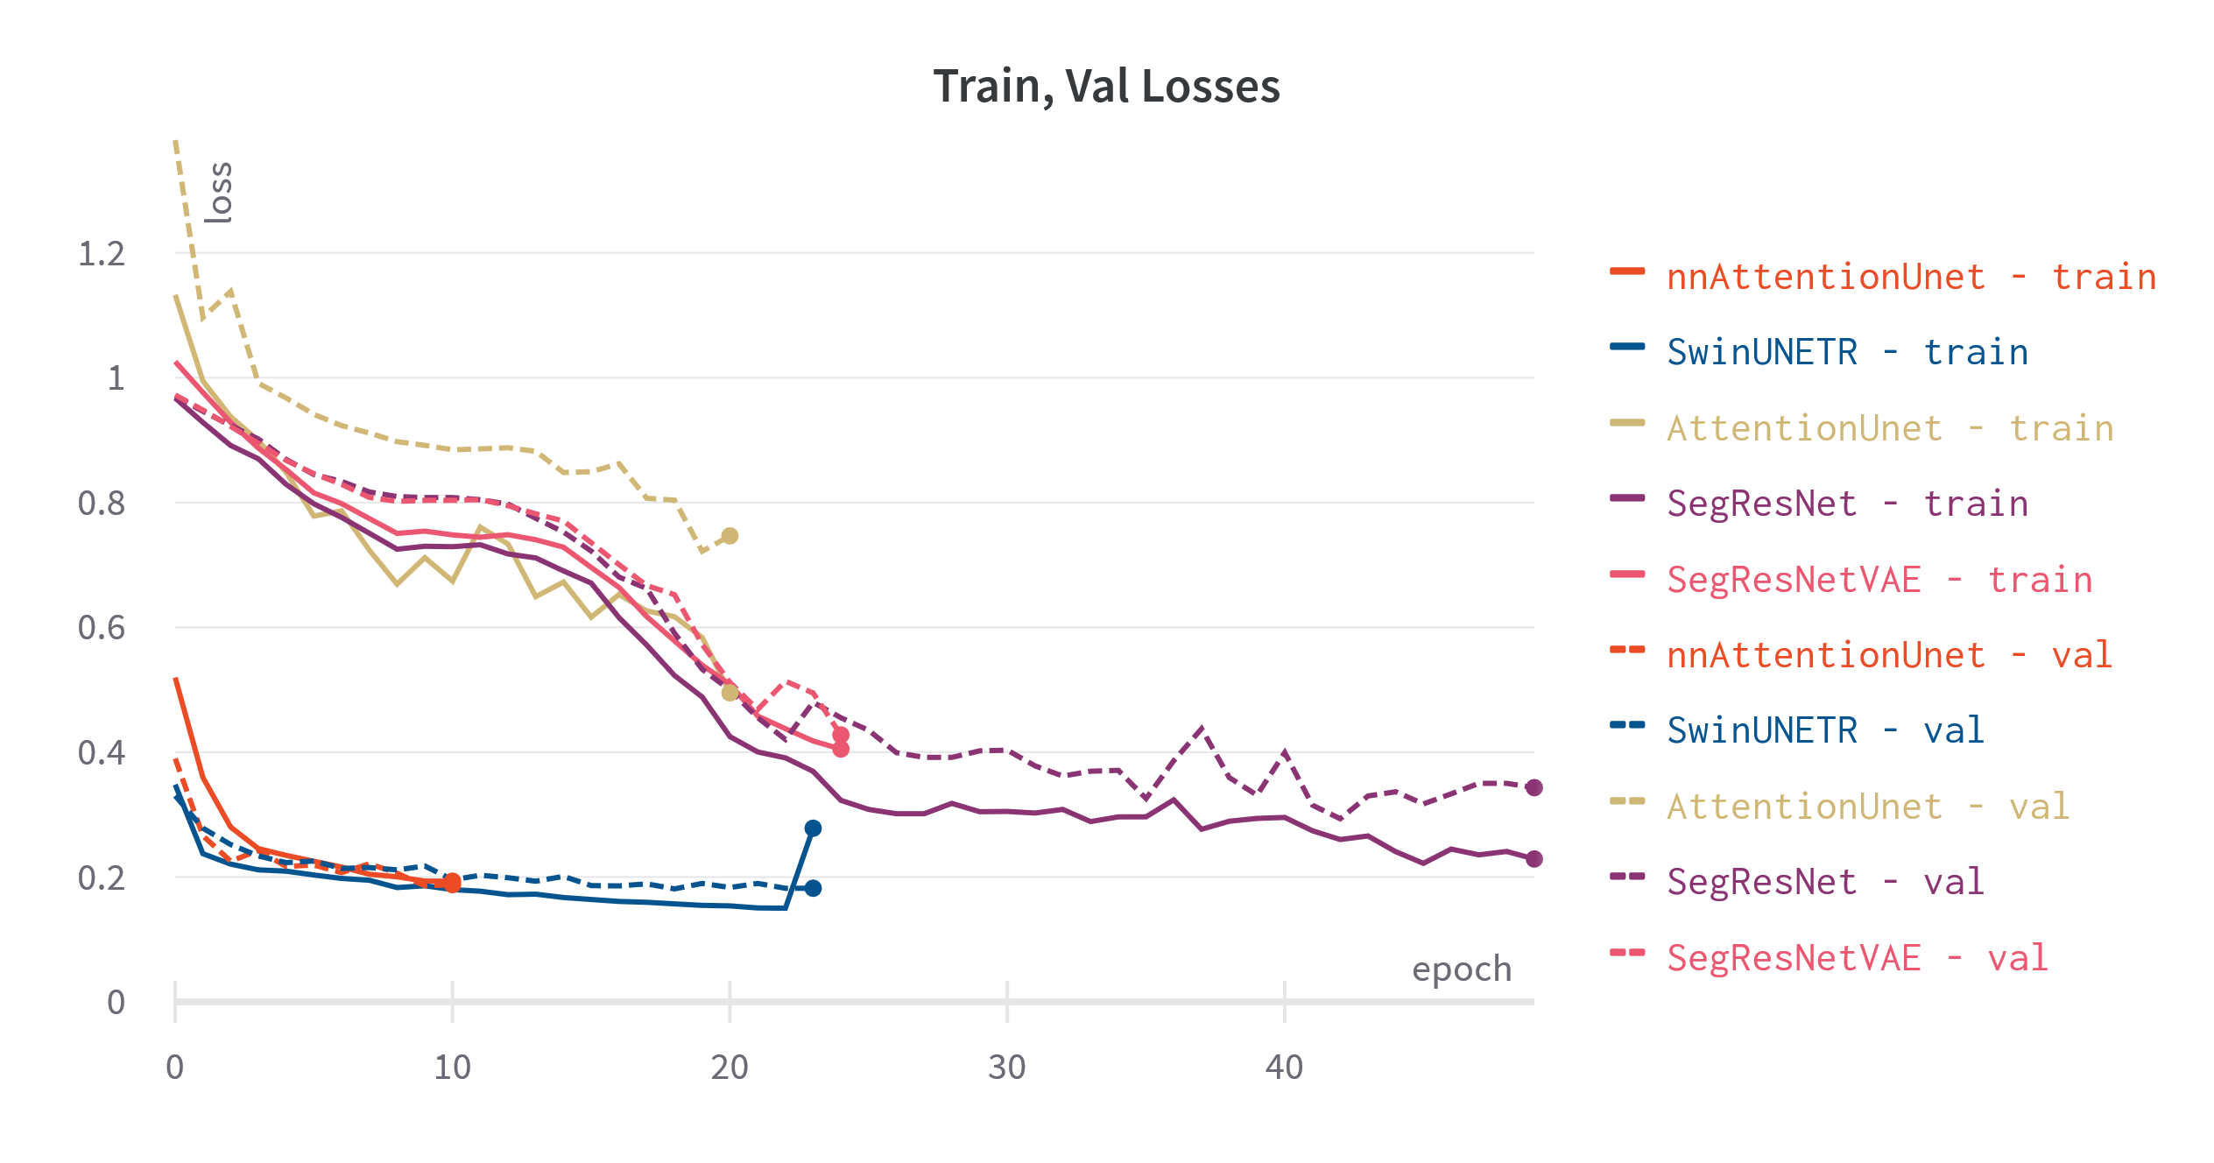

Slide 29
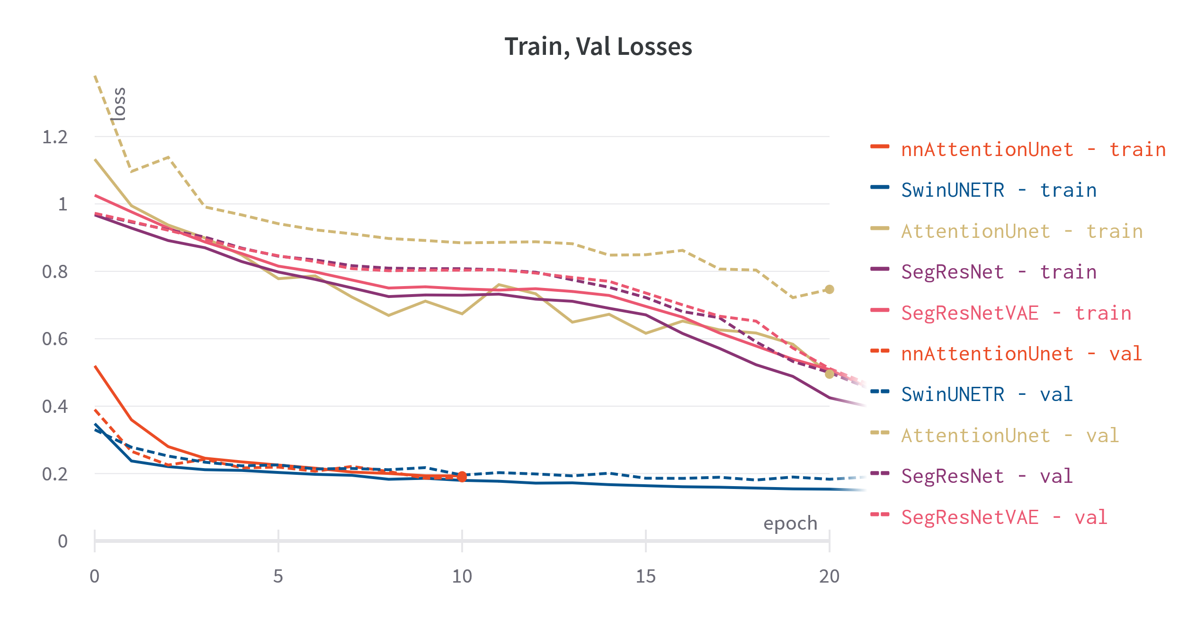

Slide 30
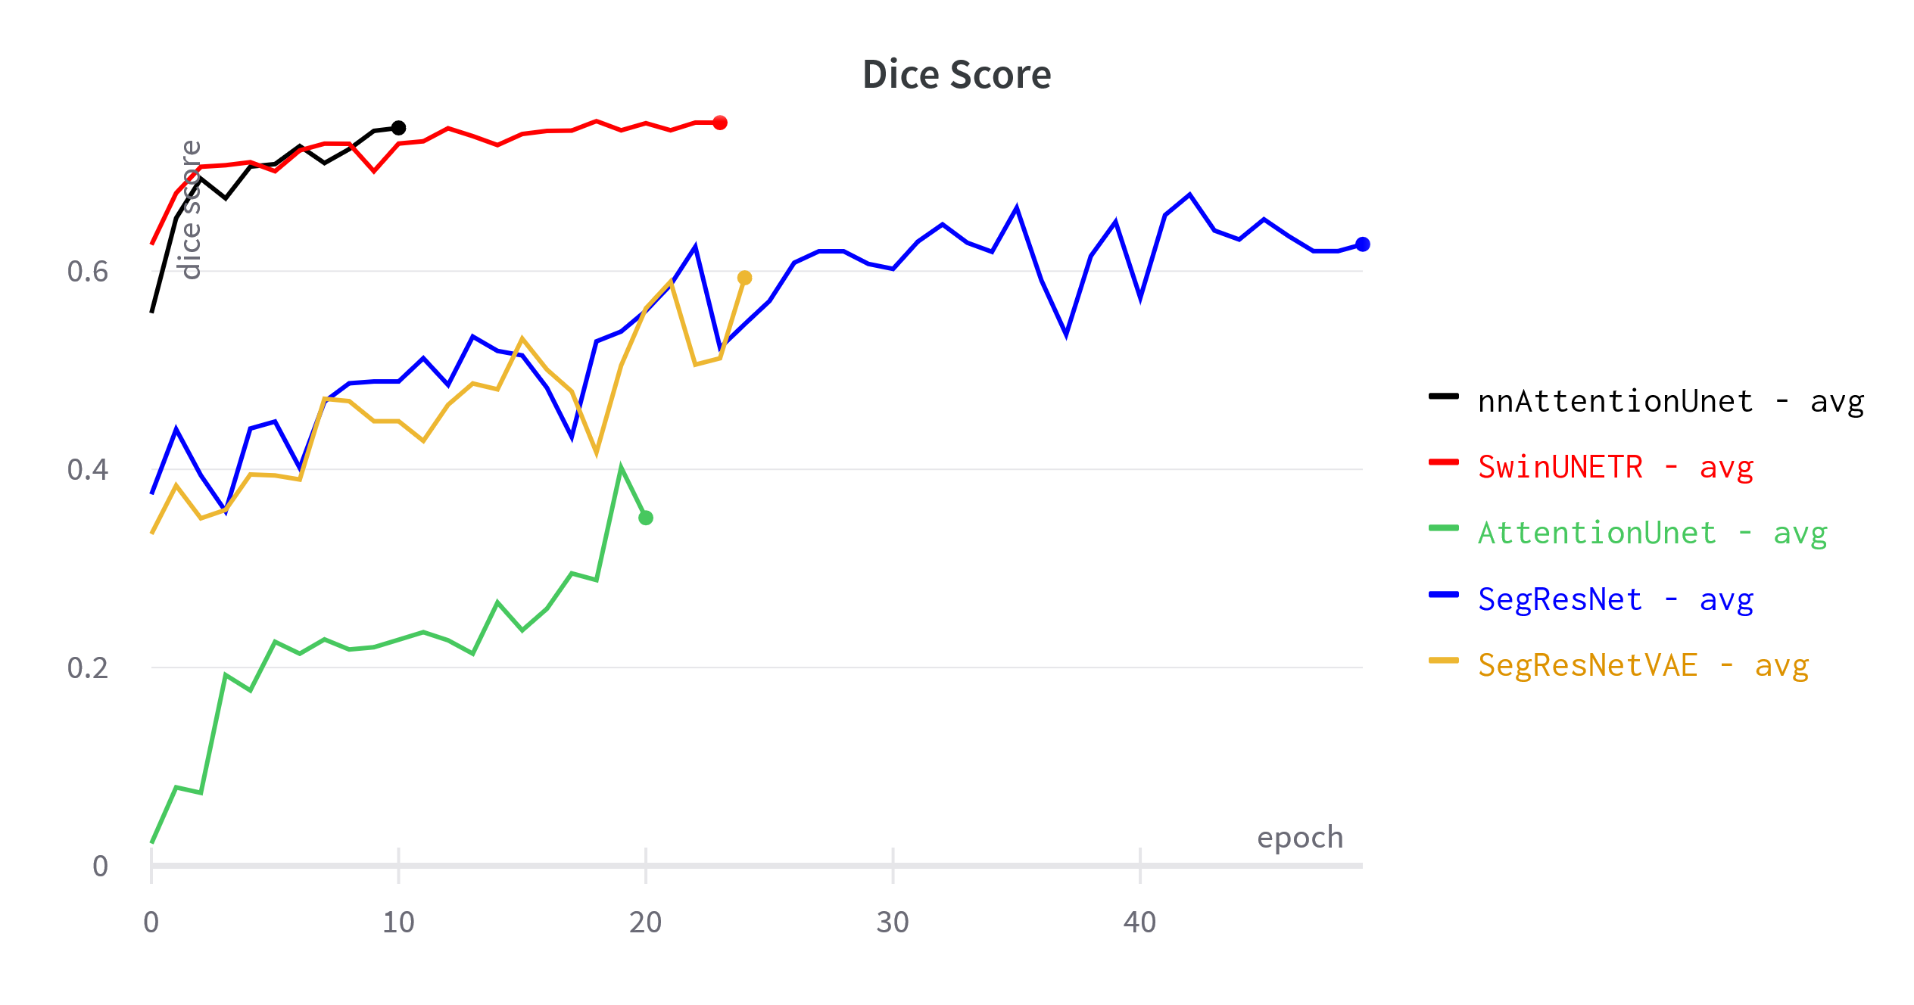
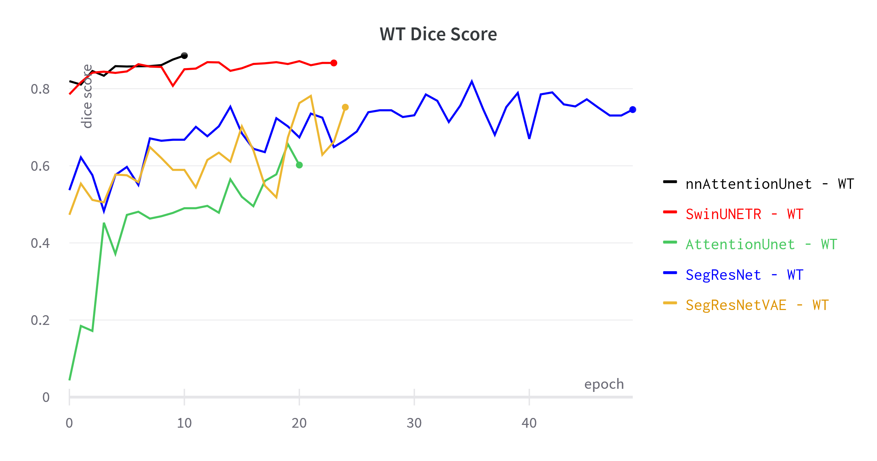
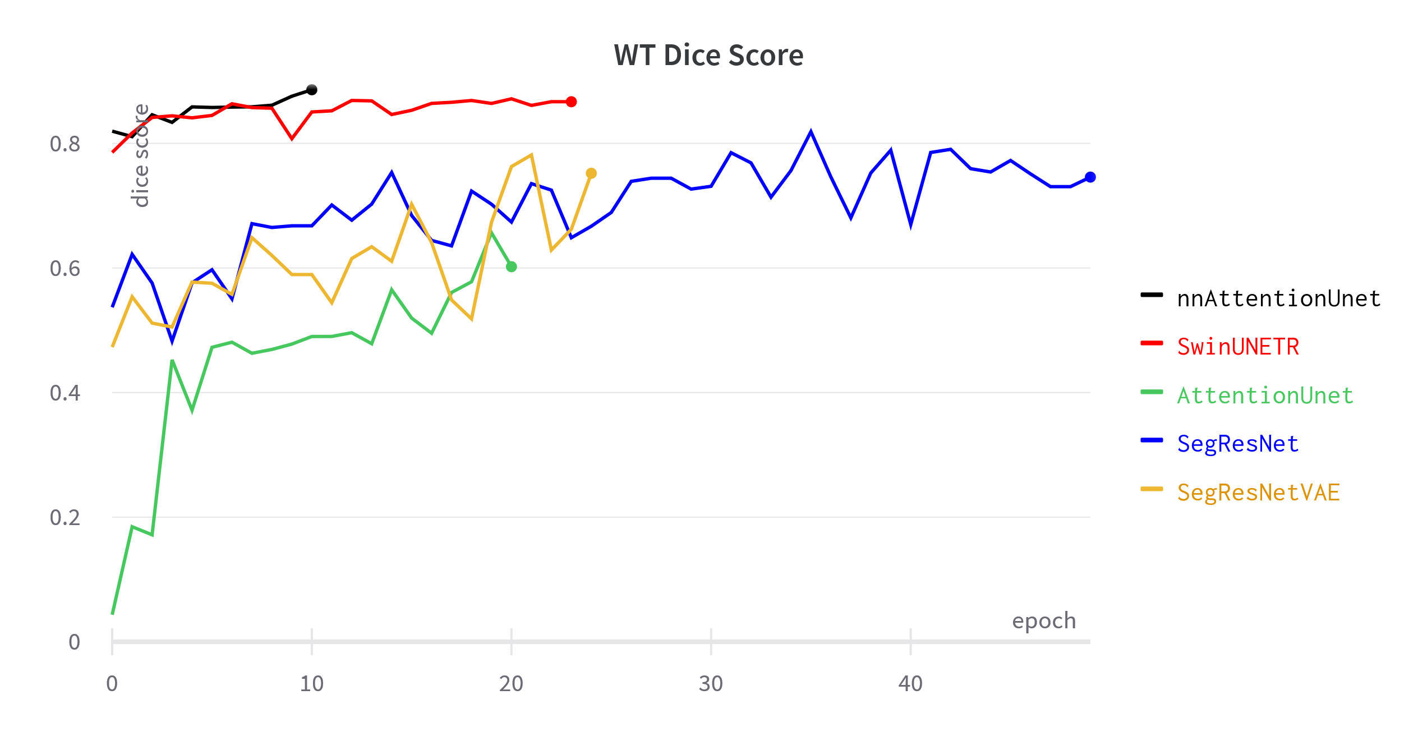
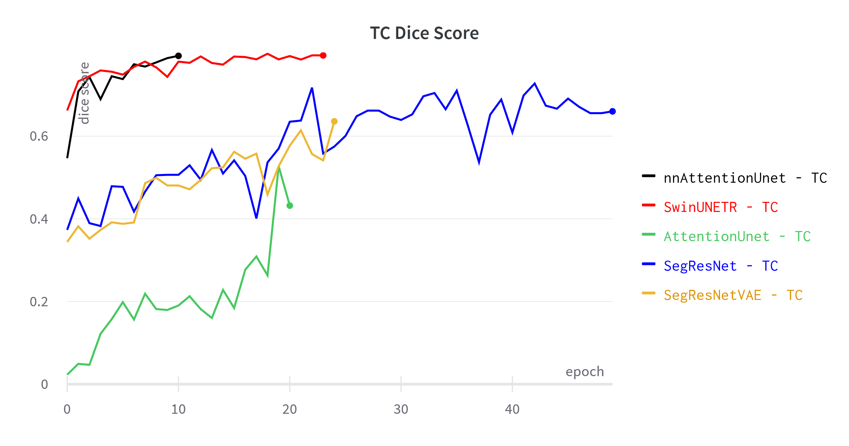
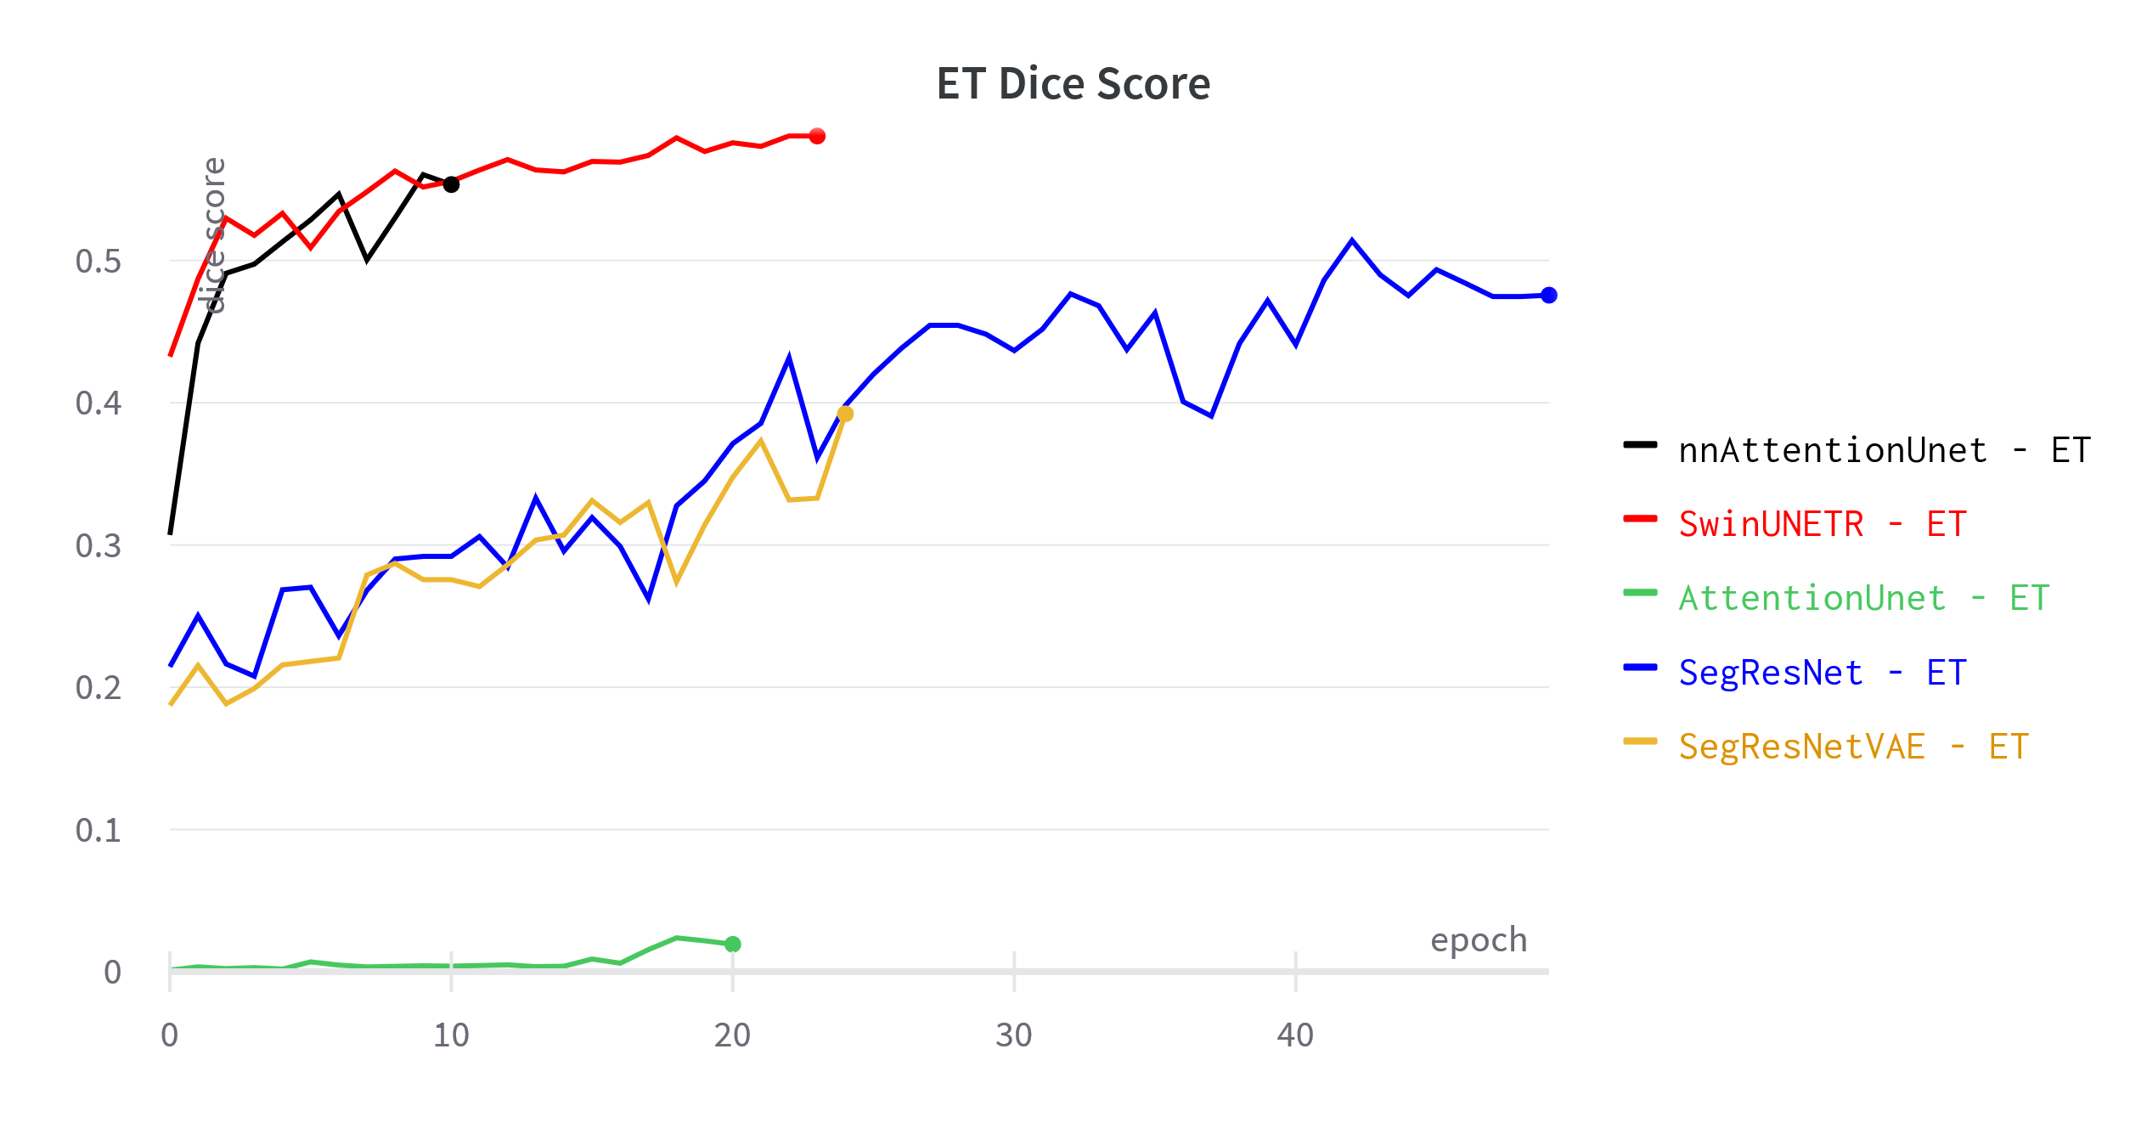

Slide 31
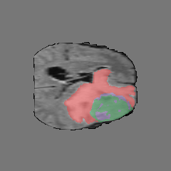
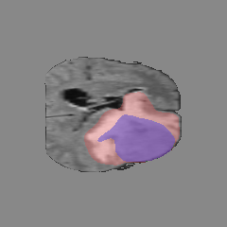
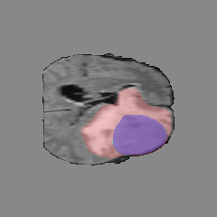
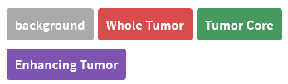
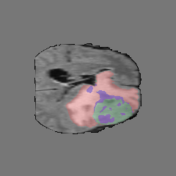
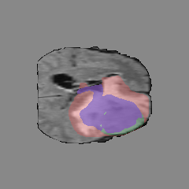
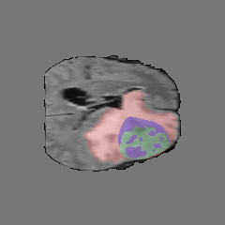
Ground truth
SegResNet
SegResNet-VAE
SwinUNETR
Attention UNet
nnAttention UNet

Slide 32
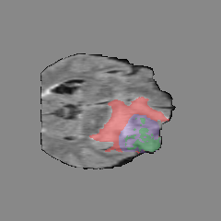
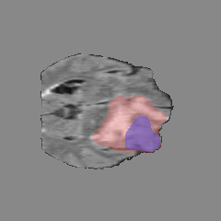

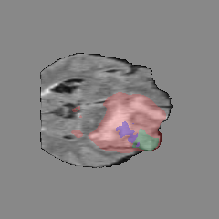
Ground truth
SegResNet
SegResNet-VAE
SwinUNETR
Attention UNet
nnAttention UNet

Slide 33
Review
Selezionare per scrivere o eliminare il sottotitolo

Slide 34
Thanks for the Attention

